Slide 1
Loops

Slide 2
What are computers good at?
Computers are good at three things
Calculations
Formal logic
Repeating what you just asked it to do (iteration) - Loops
Coincidently
Three things humans tend to struggle with
If you understand
Calculations
Formal Logic
And Loops
You will be able to accomplish impressive programs

Slide 3
Loop Types in Java (and most langs)
While Loops
For Loops
For:each loops (we will cover this later)
Do While loops (we will cover this later)
All loops have
An iterator - a way to cycle through the values you want to look at
A condition to exit (else, your computer blows up - it happens to everyone)

Slide 4
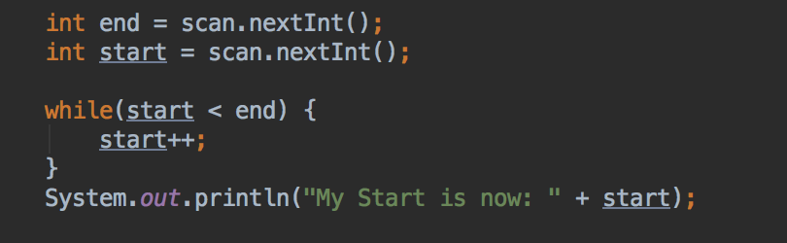
While Loop
Good when:
Your “iteration” variable is created outside the loop
You need your iterator variable outside of the loop
while(TRUE-CONDITION) {/*block of code to execute*/}

Slide 5
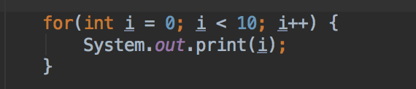
For Loop
Good when:
Your loop has a set start and end
You don’t need to keep your iterator outside the loop
for(variables; condition; iterator) { /* block of code to execute*/ }

Slide 6
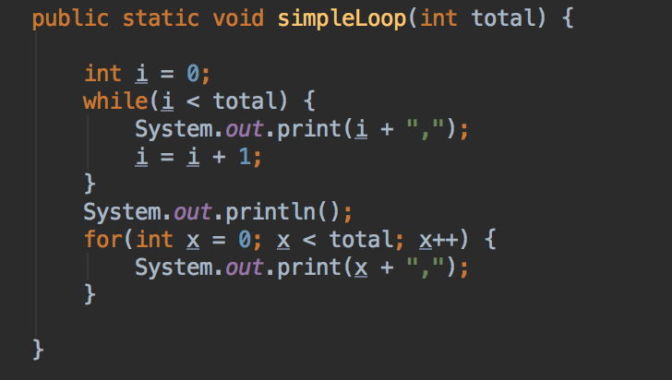
While/For Mostly Interchangeable
Let total = 10
0,1,2,3,4,5,6,7,8,9,

Slide 7

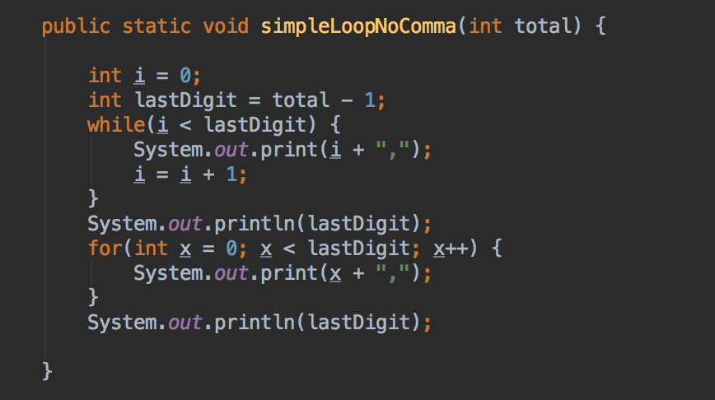
Trailing Comma?
What if I wanted to write same simple loop, but
NO trailing comma?
Let’s face it, that looks bad and probably isn’t what we want

